Slide 1
Sammlung
Jonas Oberröhrmann

Slide 2
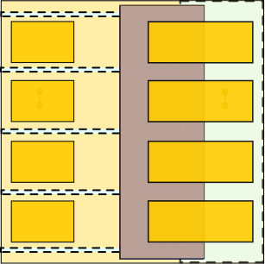
Aufbau der Perowskitzelle
Glas
Substrat: laserstrukturiertes ITO-Glas
HTL/ETL: Löcherleitender-/ Elektronenleitender Kontakt
Abscheidung durch thermisches Verdampfen
Strukturierung durch Masken
Beleuchtung durch die Glasseite
Zelldesign hier: 4 „Streifenzellen“ mit je 12mm² Fläche auf 2,5 cm x 2,5 cm ITO-Glassubstrat
Alle Schichten außer MAPbI3: Gleiche Dicke bei jedem Prozess (+/-10%)
180 nm ITO
10 nm spiro-TTB (HTL)
Au
400-550 nm MAPbI₃
23 nm C60 (ETL)
8 nm BCP (ETL)
100 nm Au

Slide 3
ITO
Glas
Indium Tin Oxide (ITO)
Conducting layer for the following stack.
180 nm ITO

Slide 4
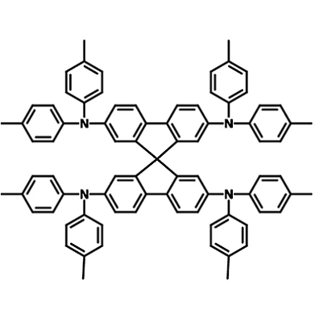
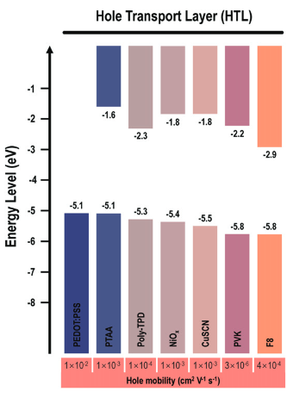
Spiro-TTB
Spiro-TTB
Hole transmission layer
Electron rich
„Compared to Spiro-OMeTAD, Spiro-TTB is less electron-rich, with four methoxyl groups being replaced by four methyl groups. It has a deeper HOMO energy level, which gives greater V_{OC}, thus, better device performance can be expected.” (https://www.ossila.com/products/spiro-ttb)
Glas
180 nm ITO
10 nm spiro-TTB

Slide 5
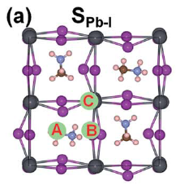
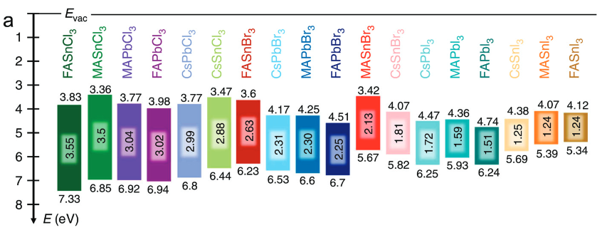
MAPbI3
Perovskite
Bandgap of about 1,7 eV (760 nm)
Degradation under light, water, oxygen
High diffusion length, conductivity
Glas
180 nm ITO
10 nm spiro-TTB (HTL)
400-550 nm MAPbI₃
2019 Photo-oxidative degradation of methylammonium lead iodide perovskite
https://doi.org/10.1088/1361-6633/abefba

Slide 6
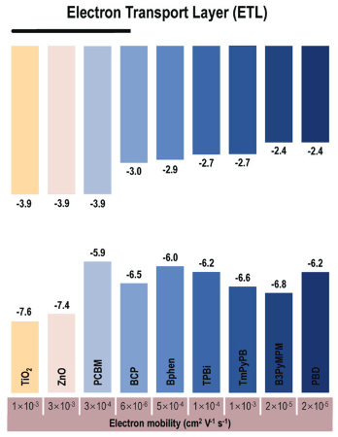
C60 - BCP
Glas
180 nm ITO
10 nm spiro-TTB (HTL)
400-550 nm MAPbI₃
23 nm C60 (ETL)
C60 and BCP
Electron Transmissive Layer (ETL)
8 nm BCP (ETL)

Slide 7
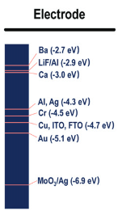
Contacts
Glas
Gold Contacts
180 nm ITO
10 nm spiro-TTB (HTL)
Au
400-550 nm MAPbI₃
23 nm C60 (ETL)
8 nm BCP (ETL)
100 nm Au

Slide 8
